Slide 1

Uidai Hackathon
Address update
ADRESS FORMATTING ISSUE

Slide 2
Flow Chart
Start
Menu driven ask if want to edit again or enter another data
Collect Data
Stop
Check locality duplication in locality, district, city
NO
If sub-locality is different, Don’t merge
Extract the text and compare it to the standard format
Delete duplication and merge that to one field
YES
Display

Slide 3
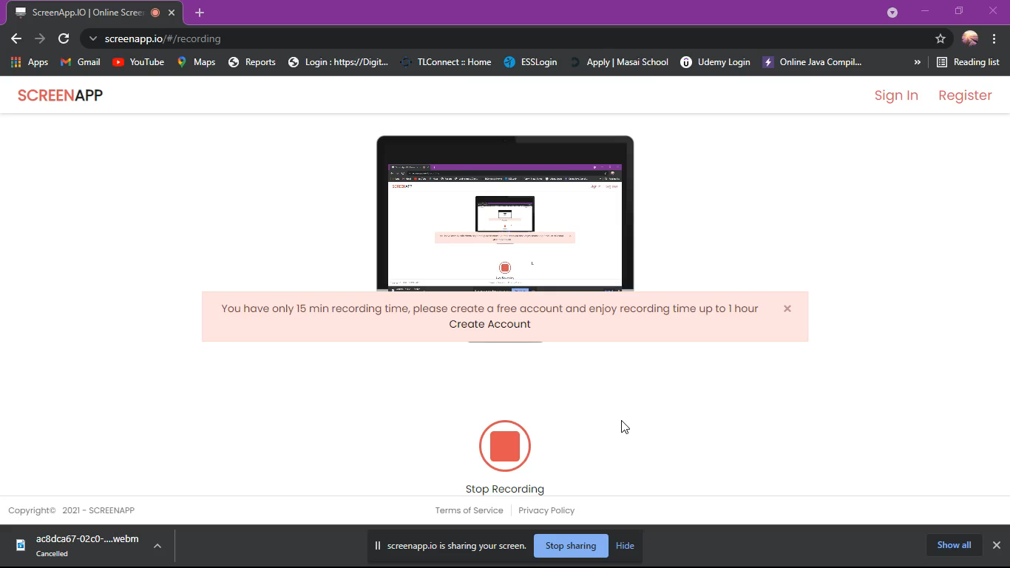
Working code video

